Slide 1

Marteking campaign analysis

Slide 2
Data set information
Context
Variables
The data is related with direct marketing campaigns of a Portuguese banking institution.
The marketing campaigns were based on phone calls.
Customer’s personal information
Information on last contact of the current campaign
Information on previous campaigns
Information on social and economic situation

Slide 3
Result of data exploration and cleaning
Check for missing values and filter outliers
Subset by numeric and categorical data
* Numerical data : Analysis on Python
* Categorical data : Analysis on Tableau

Slide 4
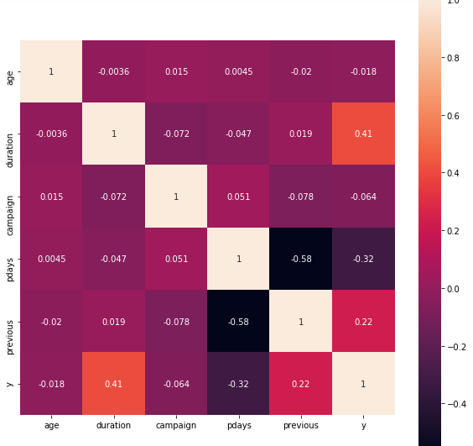
Duration of the last call with customer is the most correlated variable with the subscribed or not variable.
Other numeric variables are not correlated with this variable

Slide 5
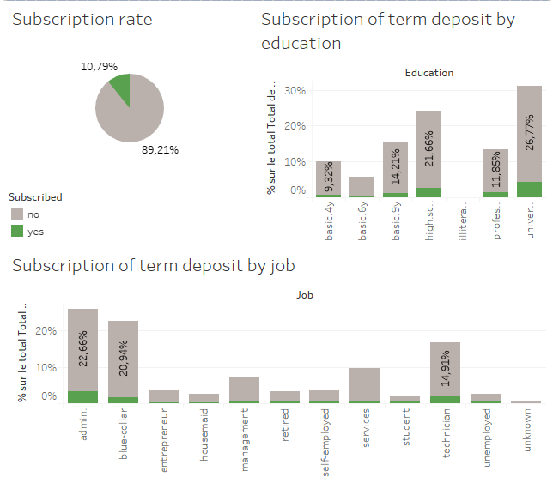
11% of the contacted customers subscribed a term deposit
Most of the subscribers are well educated and administrators, blue collars or techniciens

Slide 6
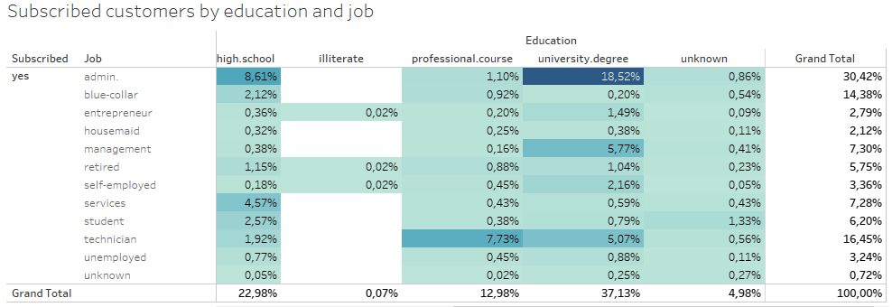
A confirmation of the graphs above : 60% of the subscribed customers have a high school diploma or a university degree. 45% of them are administrator or blue collar

Slide 7
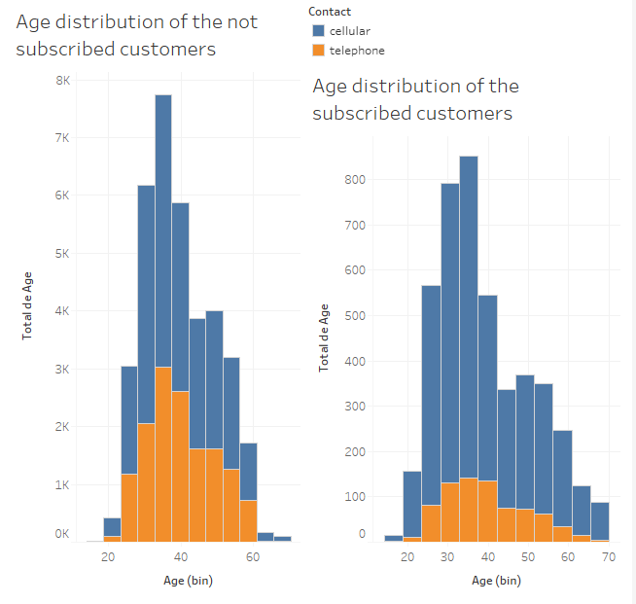
Distribution of the Variable age is almost the same between customers who subscribed or not subscribed a deposit term

